Slide 1
Topic 7
Introduction to Data Warehouse
SECD2523 Database
Semester 1 2022/2023

Slide 2
Learning Objective
The main concepts and benefits associated with data warehousing.
How online transaction processing (OLTP) systems differ from a data warehouse.
The problems associated with data warehousing.
The architecture and main components of a data warehouse.

Slide 3
Data Warehousing:
Early definition:
A subject-oriented, integrated, time-variant, and non-volatile collection of data in support of management’s decision-making process (Inmon, 1993).

Slide 4
Data Warehousing:
A consolidated/integrated view of corporate data drawn from disparate operational data sources and a range of end-user access tools capable of supporting simple to highly complex queries to support decision making.

Slide 5
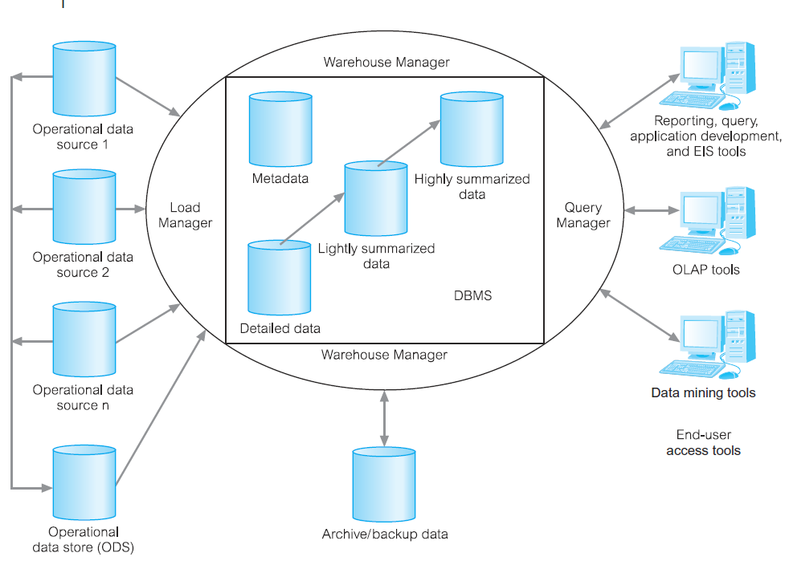
Example
The typical architecture of a data warehouse

Slide 6
Characteristics of data in DW
The data held in a data warehouse is described as being subject-oriented, integrated,
time-variant, and nonvolatile (Inmon, 1993).
Subject-oriented
Integrated
Time-variant
Non-volatile
The warehouse is organized around the major subjects of the enterprise (e.g. customers, products, and sales) rather than the major application areas (e.g. customer invoicing, stock control, and product sales).
This is reflected in the need to store decision-support data rather than application-oriented data.
The data warehouse integrates corporate application-oriented data from different source systems, which often includes data that is inconsistent.
The integrated data source must be made consistent to present a unified view of the data to the users.
Data in the warehouse is only accurate and valid at some point in time or over some time interval.
Time-variance is also shown in the extended time that the data is held, the implicit or explicit association of time with all data, and the fact that the data represents a series of snapshots.
Data in the warehouse is not normally updated in real-time (RT) but is refreshed from operational systems on a regular basis. (However, emerging trend is towards R T or near RT DWs)
New data is always added as a supplement to the database, rather than a replacement.

Slide 7
Benefits of Data Warehousing
Successful implementation of data warehouse can bring major benefits to an organization:
Potential high returns on investment
Competitive advantage
Increased productivity of corporate decision-makers

Slide 8
Design of Data Warehouse
Dimensionality Modeling
A logical design technique that aims to present the data in a standard, intuitive form that allows for high-performance access.
Two types in general:
  Star schema
  Snowflake schema

Slide 9
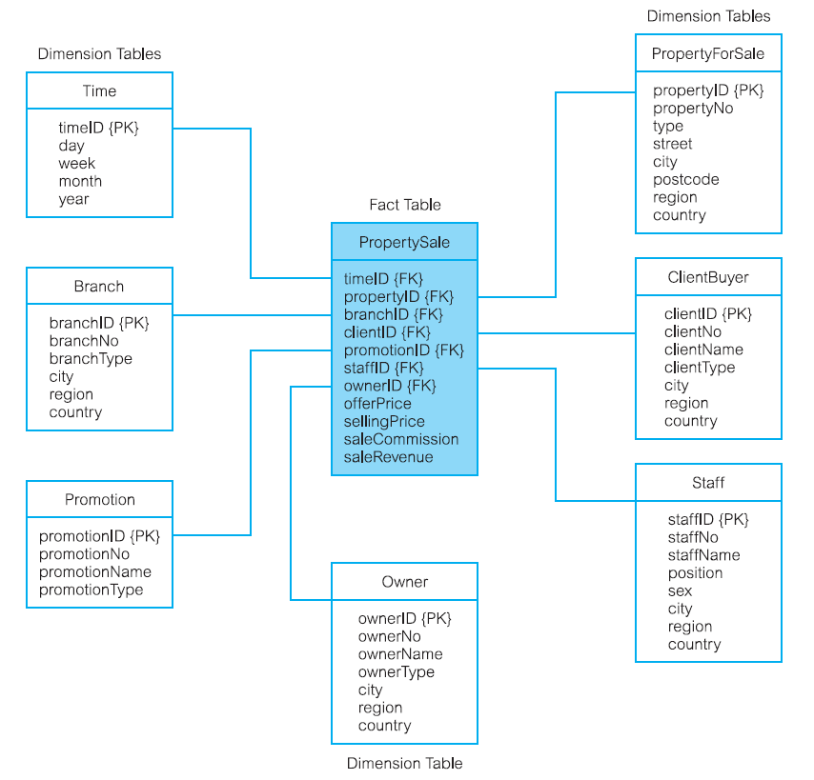
Star Schema
A dimensional data model that has a fact table in the center, surrounded by denormalized dimension tables.

Slide 10
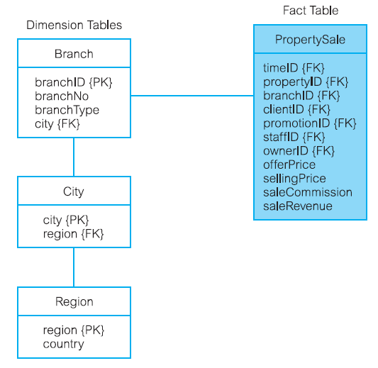
Snowflake schema
A dimensional data model that has a fact table in the center, surrounded by normalized dimension tables.

Slide 11
Online Analytical Processing (OLAP)
Original definition - The dynamic synthesis, analysis, and consolidation of large volumes of multi-dimensional data, Codd (1993).
Describes a technology that is designed to optimize the storing and querying of large volumes of multi-dimensional data that is aggregated (summarized) to various levels of detail to support the analysis of this data.
Enables users to gain a deeper understanding and knowledge about various aspects of their corporate data through fast, consistent, interactive access to a wide variety of possible views of the data.
Allows users to view corporate data in such a way that it is a better model of the true dimensionality of the enterprise.

Slide 12
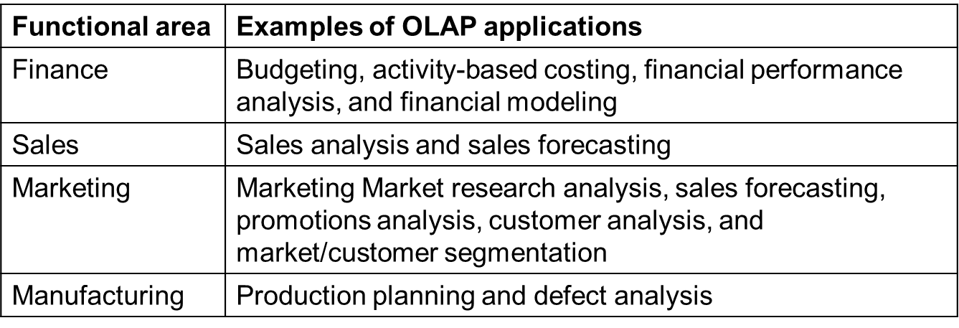
Examples of OLAP Applications in Various Functional Areas

Slide 13
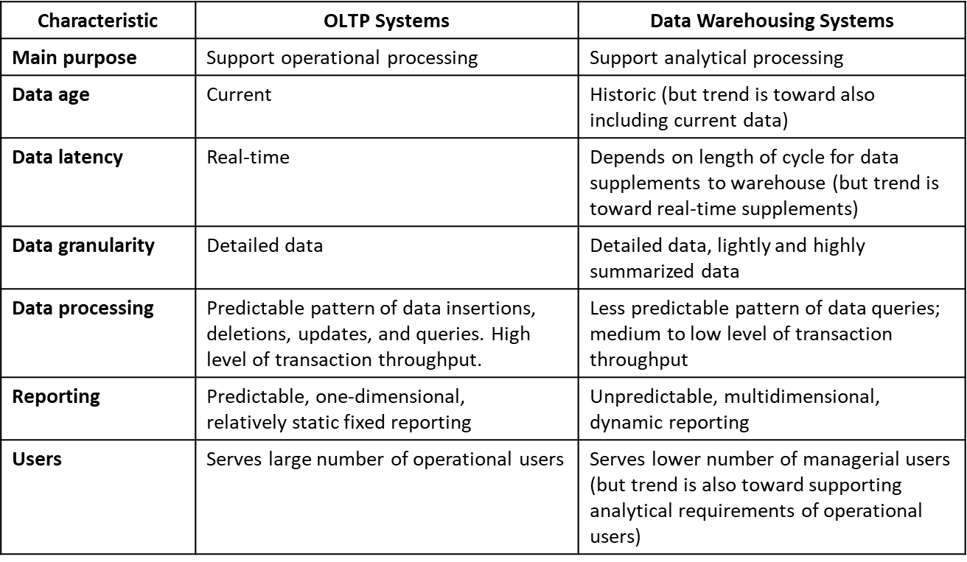
Comparison of OLTP Systems and Data Warehousing
A DBMS built for online transaction processing (OLTP) is generally regarded as unsuitable for data warehousing, because each system is designed with a differing set of requirements in mind.
For example, OLTP systems are designed to maximize the transaction processing capacity, while data warehouses are designed to support ad hoc query processing.

